Slide 1
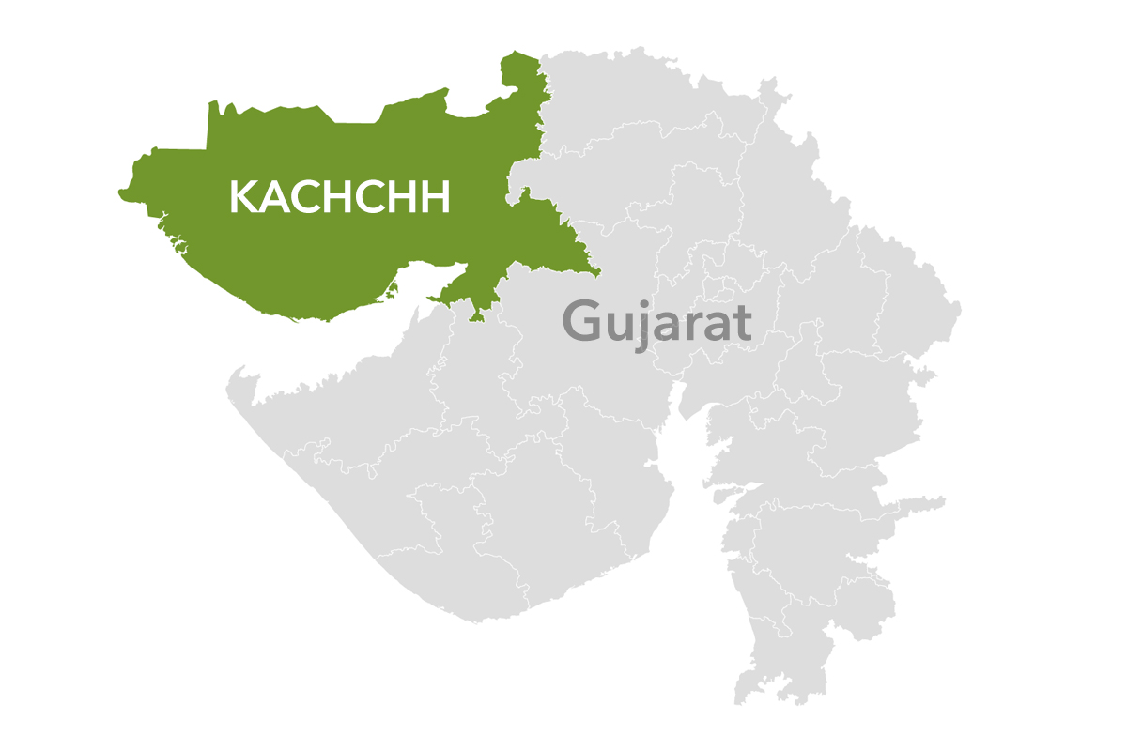

Slide 2
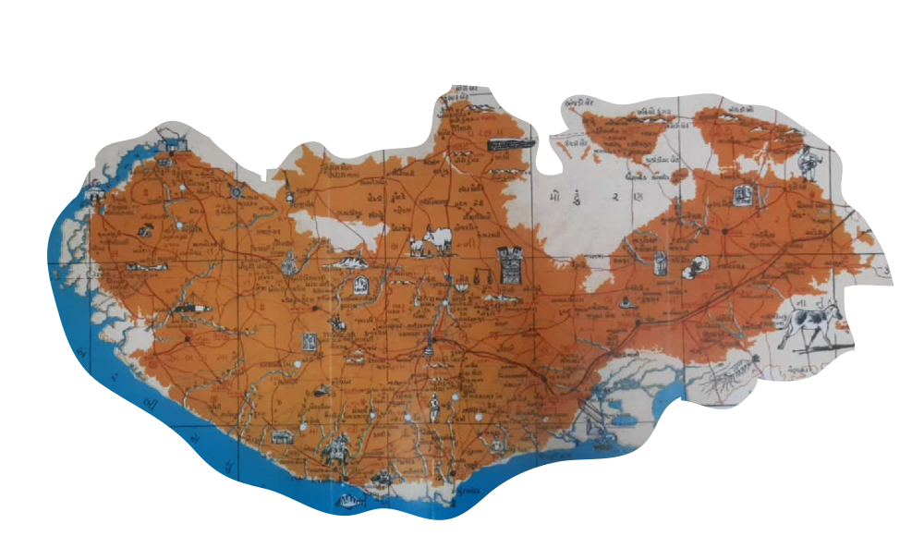
ORAL HISTORY OF KUTCH
To explore the cultural power of the region, we have designed a comprehensive Oral History program on Kutch.
To establish cultural identity of Kutch.
To preserve for posterity Oral Tradition/s for the future generation of Kutch.
To pave the way for scientific documentation and create Digital Archive of Kutch.
To create exhaustive Audio-Visual footage bank, to design for the most advance products in order to appeal younger generations with futuristic approach
To create an Institution, which will carryon and preserve the legacy
To consolidate the work done by several legends and to avoid repetition by creating one Umbrella organization

Slide 3
To present and promote the heritage of Kutch globally.
To promote art and culture of Kutch.
To document and record materials of items pertaining to heritage of Kutch wherever they maybe.
To provide and make information available to the public via print, digital, and electronic media relating to cultural heritage of Kutch.
To meet the technical requirements for preserving endangered Kutchi heritage objects in India.
OBJECTIVES

Slide 4
PROJECT BRIEF
As a nation or region, Kutch have a distinct identity and culture, which needs to be conserved through authentic documentation. With technological advancements, we now have the means and methods to preserve and maintain it, thus, it is our responsibility to save it in a more meaningful way with a modern approach.
We have lost numerous historical documents over the period of time due to natural disasters. To promote and preserve the heritage of Kutch, a feature in an audio-visual media form that includes graphics, images, and statistics is a need of an hour and the same can be accompanied by the Oral History of Kutch, which will be a mixture of regional sound and music.
Every human being holds history with them through their actions over time. This history must be recorded orally, textually, audibly (written), and now in cinema format, as new digital technology has made it probable so that it can be contemplated globally through the most recent outlets.

Slide 5

Vision
To highlight and preserve the rich cultural heritage of Kutch.
To collate the Oral History of Kutch which shall help us to inculcate the past history accompanied with experience.
Mission
To create unique and user-friendly database on Kutch (Subjective & Objective).
To create Digital Archive (Documents, Photographs, Sound and Music) of Kutch.
To collect and visually present information about Kutch's history.
To collect and preserve Oral histories of the Kutch community, tribes, culture, food, religion, people, etc.
We accomplish this by conducting interviews, making oral history audio recordings and transcripts available to the public, creating and promoting videos and podcasts.

Slide 6

ROAD MAP
Creating the Database on Kutch with various permutations and combinations.
Creation of Digital Archive on Kutch.
Recording of Oral History on Kutch (bilingual)

Slide 7
Create Database on Kutch with various permutations and combinations
Data base of Villages in Kutch.
Detailed list of events, earthquakes, draughts or any other such eventualities occurred in Kutch.
Statements of Individuals
List of Communities
Methodology
Creating user friendly database, with classification (subjective, objective, place and DATES), with help of indigenous software and technology.

Slide 8
Creation of Digital Archive on Kutch
Listing of Books, magazines, Journals, Research papers etc.
Collection of Photographs of events and personality.
Digitisation of Photographs, Books, with annotated index.
Transliteration of books (partly done by VRTI)
Methodology
Referring libraries, Museums,
Collectors (personal library)
Universities (Dissertations).
Individuals (Personal Collections).
Newspapers Archives and clipping centres
Listing, Scanning, Restoration, indexing, (annotated Index), linking with database
Classified storage, with locations and preservation of original material

Slide 9
(3) Recording of Oral History on Kutch (bilingual)
Converting oral history of Kutch into individual film on film format.
Exhibiting the oral history of Kutch worldwide on various platforms with proper marketing and promotion.

Slide 10
HISTORY
Create various series on various subjects like :
SOCIAL
MISSIONS
CULTURE
MEDIA
GEOGRAPHY
ECONOMY
POLITICS
EDUCATION

Slide 11
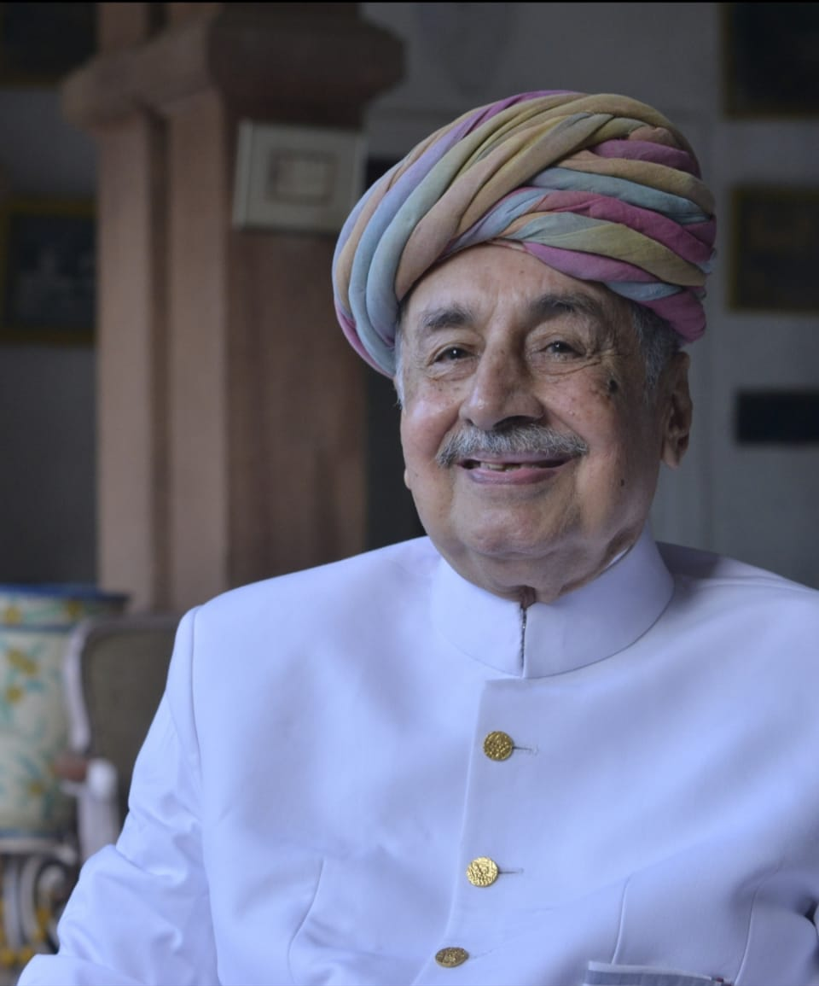
રાજાશાહી દર્શન
History of Kutch Rulers
Khengarji 1st (1510 to 1586) ruled 76 Years. Established Bhuj in 1549
Bharmalji 1st (1586 to 1632), started Kutchi Currency
Bhajrajji (1633 to 1645) – Developed Mundra Port
Khengarji 2nd (1645 to 1654)
Tamachiji (1655 to 1666)
Raydhanji 1st (1666 to 1698) constructed various forts
Pragmalji 1st (1698 to 1715) shipbuilding developed
Godji 1st (1715 to 1718)
Desalji 1st (1719 to 1752) encouraged to Art and artisans
Lakhpatji (1752 to 1761) established Vrujbhasha Pathsala
Godji 2nd (1761 to 1779) Zara War
Raydhanji 2nd (1779 to 1814)
Bharmalji 2nd (1814 to 1819)
Desalji 2nd (1819 to 1860)
Pragmalji 2nd (1860 to 1875)
Khengarji 3rd (1876 to 1942) established law and order
Vijayrajji (1942 to 1948) Vijay Vilas Palace, Vijay Sagar Dam
Maharao Madansinghji (1948 to 1991)
Pragmalji 3rd (1991 to 2021)

Slide 12
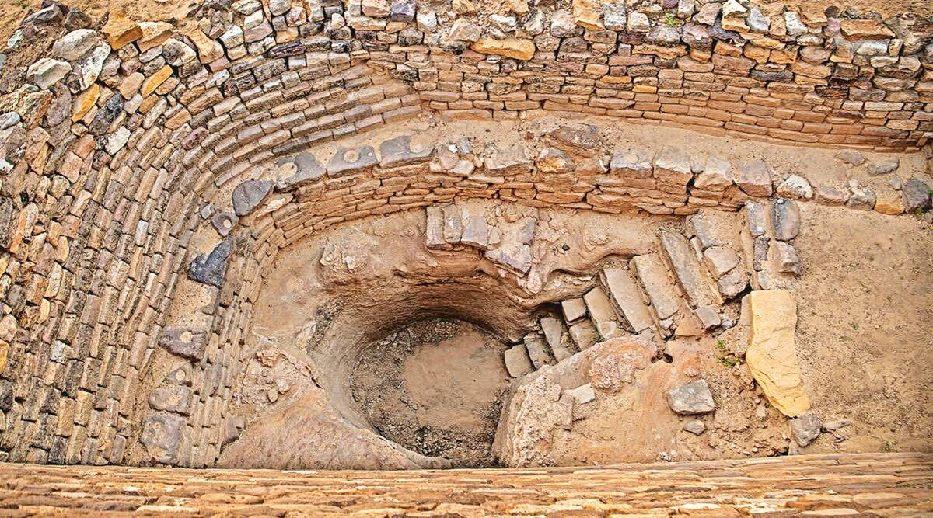
DHOLAVIRA – A HARAPPAN CIVILISATION
Dholavira's location is on the Tropic of Cancer. It is one of the five largest Harappan sites and most prominent archaeological sites in India belonging to the Indus Valley Civilization located in Kutch. It is also considered as City of Grandest of its time.

Slide 13
Focus 2022
1965 & 1971 War: Hindu Refugees (2nd July, 2022)
Legend Series
Setting-up Digital Archive.

Slide 14
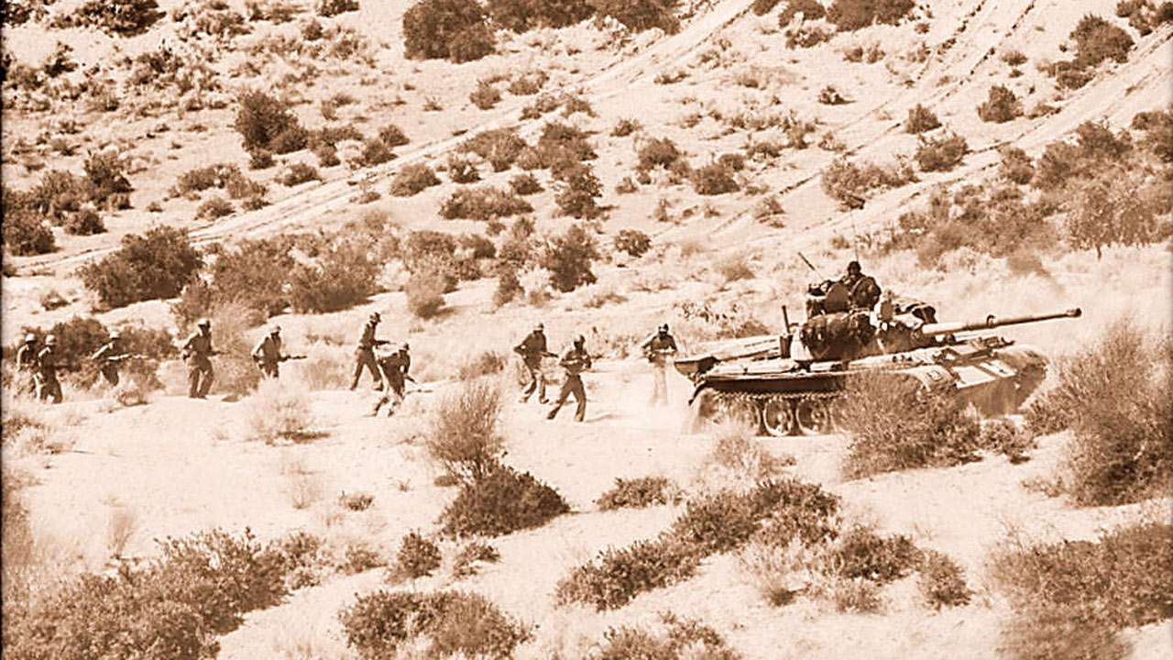
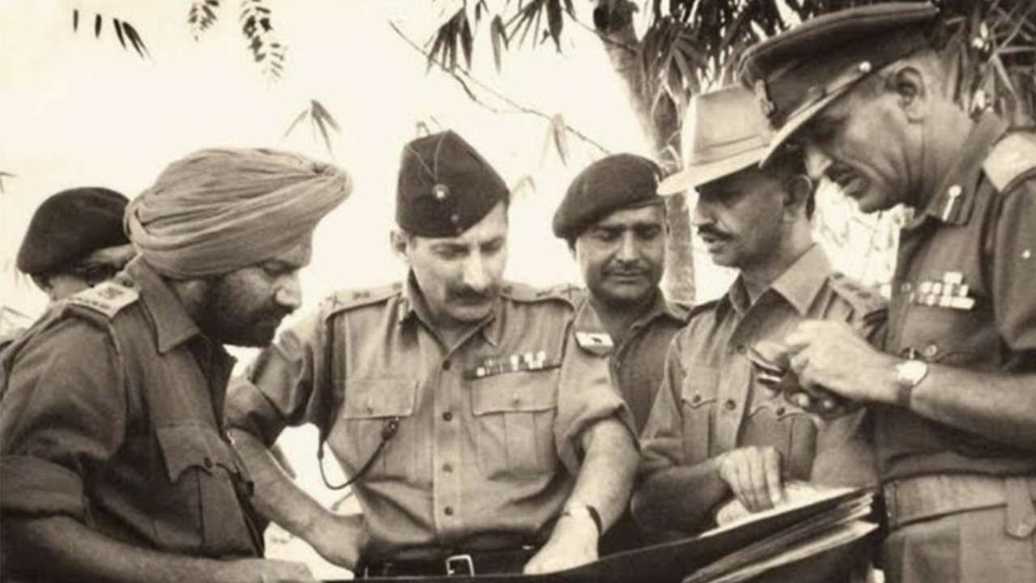

1965 & 1971 WAR
HINDU REFUGEES
During an attacked by Pakistan Army in Rann of Kutch in 1965, appropriate Border Security Forces were no deployed in Kutch for its protection. Due to a lack of aggressive approach by Indian Army and Government of India on recapturing areas of Kutch, we have lost “Chhadbet”! A historic agitation (કચ્છ સત્યાગ્રહ) organized in 1968 against the move to hand over Chhadbat to Pakistan, all opposition parties united and raised their voice against this move.
During the 1971 war, the Indian army marched from Kutch to Sindh and conquered the territory up to Nagarparkar. Had the war lasted even one more day, the independence of Sindh would have been in the handshake. But thousands of Hindu refugees reached the Kutch-Gujarat-Rajasthan border after Indian Army decided to hand over the territory won under the Shimla Agreement to Pakistan Army.
Later on, they got Indian citizenship.

Slide 15
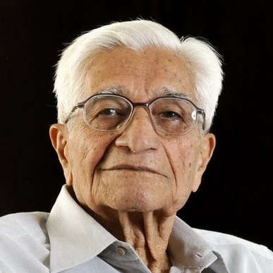
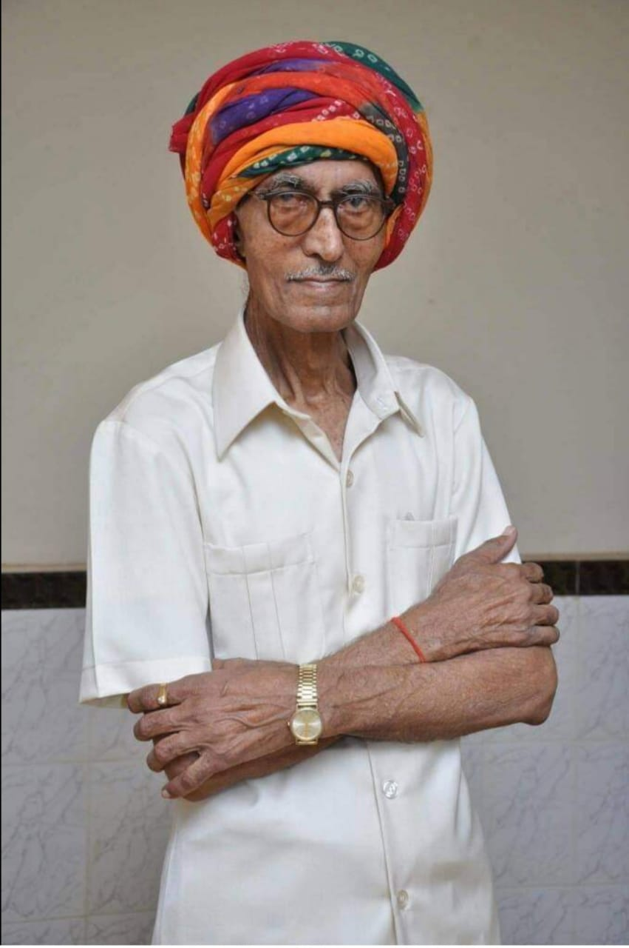
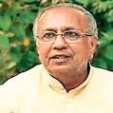
Sr No | Name | Place | Age | Category
1 | Kantisen Shroff |  | 100 | Visionary
2 | Umiyashankar Ajani | Bhuj | 88 | Historian
3 | Sureshchandra Mehta | Ahmedabad | 86 | Ex-CM, Gujarat
4 | Shivdas Patel | Bhuj | 92 | Refugee, ex Jilla Panchayat President
5 | Liladhar Manek Gada | Bhojay | 80+ | Social Worker
6 | Damjibhai Anchorwala | Kundrodi | 83 | શ્રેષ્ઠી, જીવદયા
7 | Pravinchandra N Shah | Bhuj | 91 | Kutch Critic, Writer,
8 | Ushaben Thakkar | Adipur | 80+ | Ex-MP
9 | Nirmala Asnani | Adipur |  | Vrijbhasha
10 | Ushakant Mehta | Bhavnagar | 83 | Historian, Art Critic, Collector
11 | Joravarsingh Jadhav | Ahmedabad | 80+ | Lok Sanskruti Scholar
12 | Mahesh Thakkar | Bhuj | 80 | Kutchi Samasya Scholar, ex MLA
13 | Haresh Dholakiya | Bhuj |  | Historian, Writer
14 | Vijayaben Seth |  |  | Educationist
15 | Bansidhar Maheshwari | Amdavad | 88 | Regugee, 1947
16 | Valjibhai Gadhvi | Singhodi | 88 | Politician
17 | Dev Gadhvi | Bhavnagar |  | Cartoonist
18 | Dalpath Danidhariya | Bhuj |  | Archivist
19 | Pushpadan Gadhvi | Bhuj | 80+ | Politician
20 | LD Shah | Bidada | 80+ | Social Worker
21 | Dr Girish Vichhivora | Mumbai | 90+
Legend Series
Significant Contributions

Slide 16
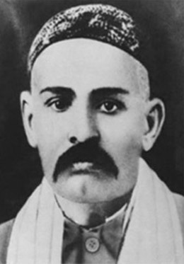
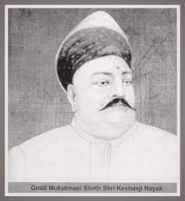
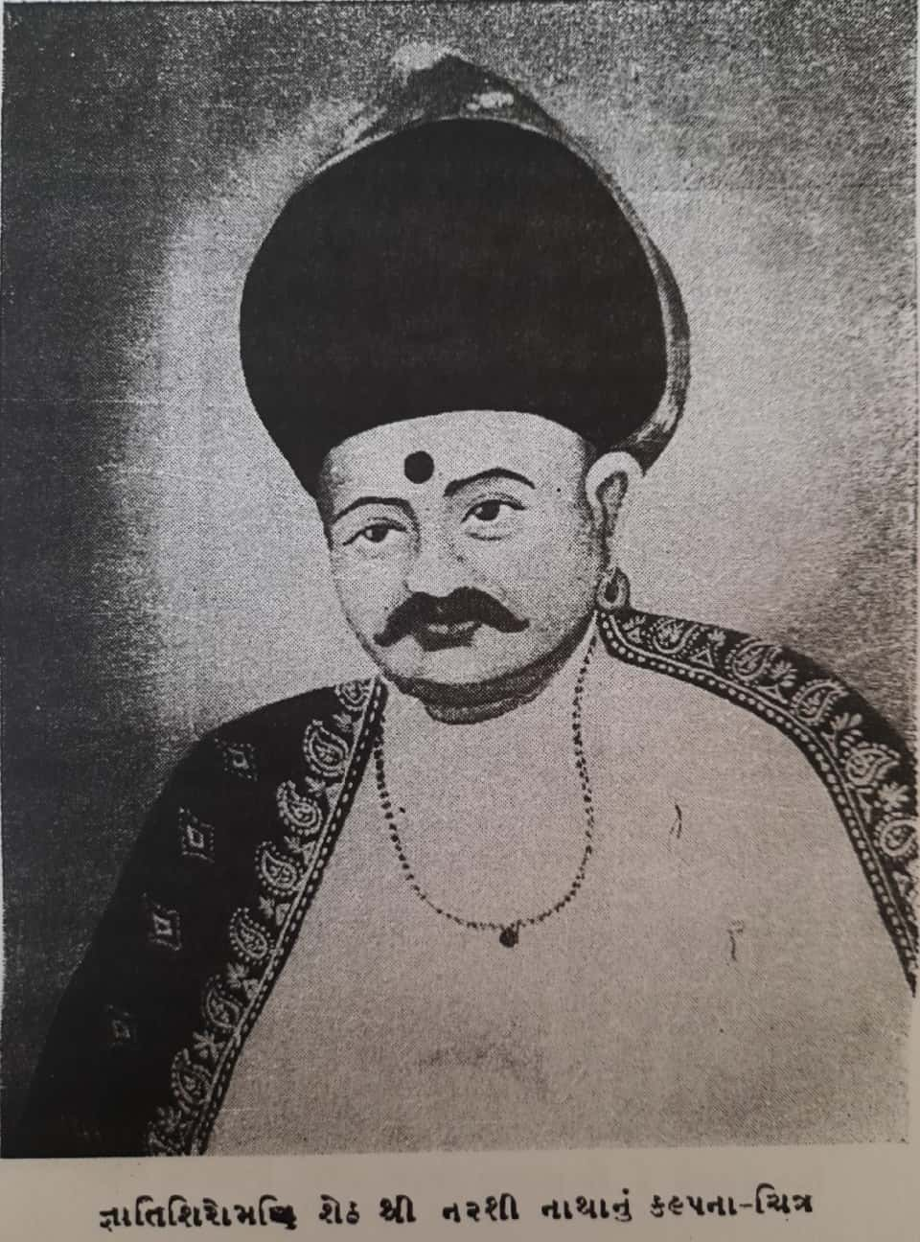
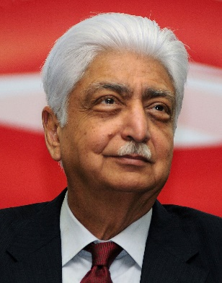
વતનપ્રેમી Kutchis outside Kutch – Migration (Love of Mother Land)
Seth Khimji Ramdas family (Muscat)
Keshavlal Premji Bhuria (East Africa)
Laxman Raghwani (East Africa)
જ્ઞાતિ મુકુટમણિ Keshavji Nayak (Mumbai)
જ્ઞાતીશિરોમની Narasi Natha (Mumbai)
Seth Lakhamsi Napoo (Mumbai)
ખીમજી રામદાસ
Entrepreneurial communities like Bhatia’s, Patel’s ventured out to Muscat, East Africa respectively and built their business empire.
Oswals (KVO, KDO), Kadwa Patidar, Lohana, Gujjar Kshtirya etc. migrated to Mumbai and spread in various parts of India.
It is only because of these migrations, the population of Kutchi’s outside Kutch is larger than those living in Kutch.

Slide 17
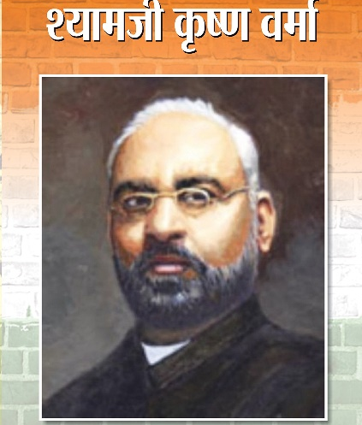
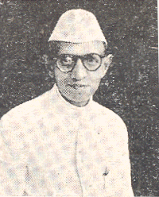
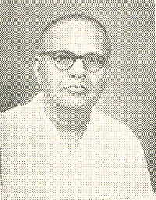
75 YEARS OF INDEPENDENCE – POLITICAL MOVEMENT
Shyamji Krishna Verma
Kantiprasad Anjani
Velji Thakarsi
Jamnadas Gandhi
Nanalal Fokaliya
Yahub Hussain
Yusuf Meherali
Velji Lakhamsi
Laxmidas Ravji
Mulraj Karsandas
Bihari Antani
Bhawanji Ajran Khimji
Kundanlal Dholakia
Premji Thakkar
Gulabshankar Dholakia
Velji Thakarsi (Bidada)
Jethibai Khatri
Shri Gulabshankar Amritlal Dholakia
Many freedom fighters took part in India’s Independence like Shyamji Krishna Verma, Gulabshankar Amritlal Dholakia, Bhawanji Khimji Arjan, Panbai (Koday) and so on…
Their contribution should be highlighted.

Slide 18
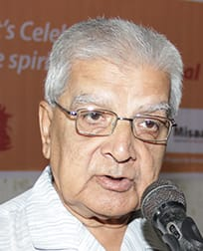
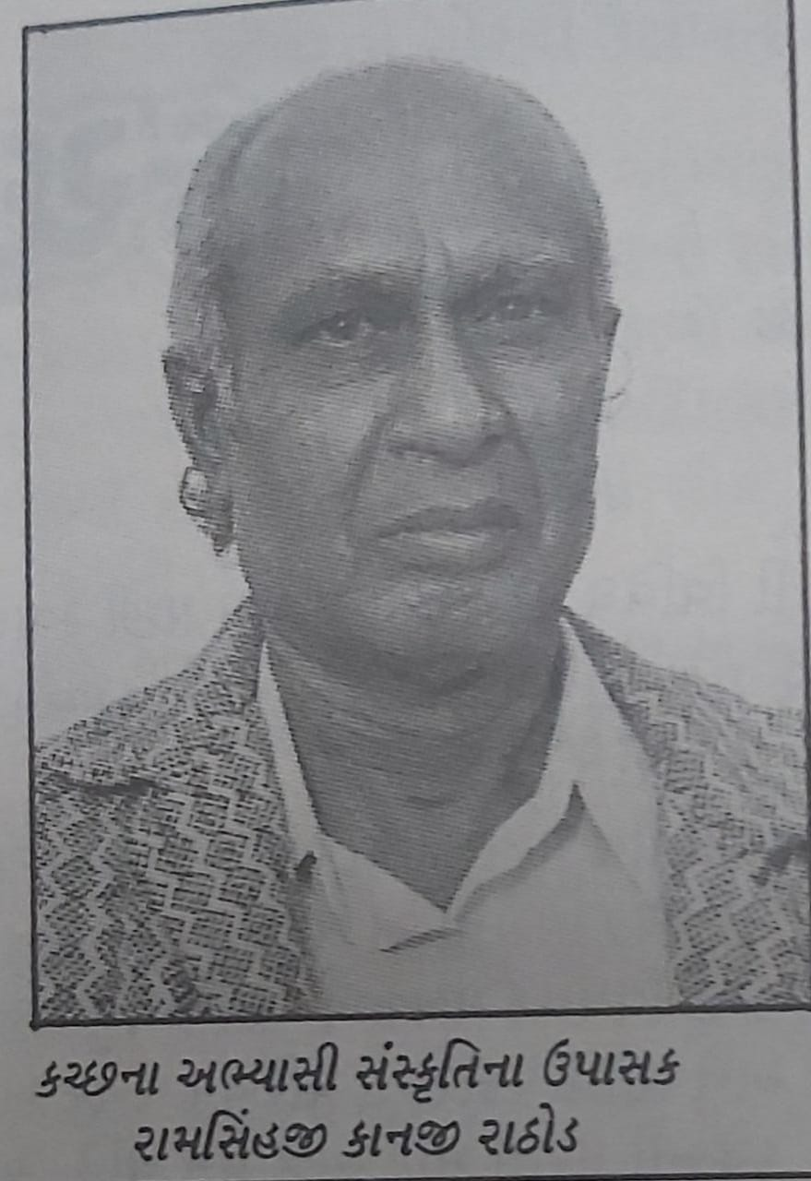
Chatarbhuj Shivji
Shivji Devsi Madhdawala
Atmaram Keshavji Dwivedi
Dungarsi Dharamsy Sampat
Dulerai Karani
Joravarsingh Jadhav
Ushakant Mehta
Ramsinghji Rathod
Umiyashankar Ajani
Haresh Dholakia
Naresh Antani
HISTORIANS & COLLECTORS
Since the last two hundred years, history has been written on and about Kutch, beginning with Capt James Mac Mardo.
History must be preserved for posterity, and historians' contributions must be recognised. We could get Manuscripts, handwritten letters, diaries, and photographs must be archived and converted into museum exhibits...

Slide 19
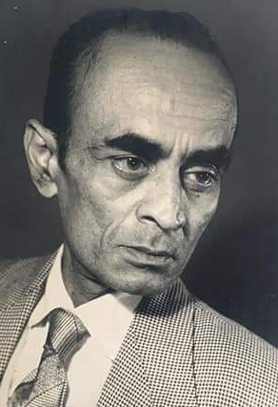
Short Story Writers & Novelists
Jayant Khatri
Narayan Visanji Thakkar
Gunwantrai Acharya
Vanu Pandhi
Manu Pandhi
Vinesh Antani
Mavji Maheshwari
Madhushudan Bhatt
Dhirendra Mehta
Chandrashankar Buch ‘Sukani’

Slide 20
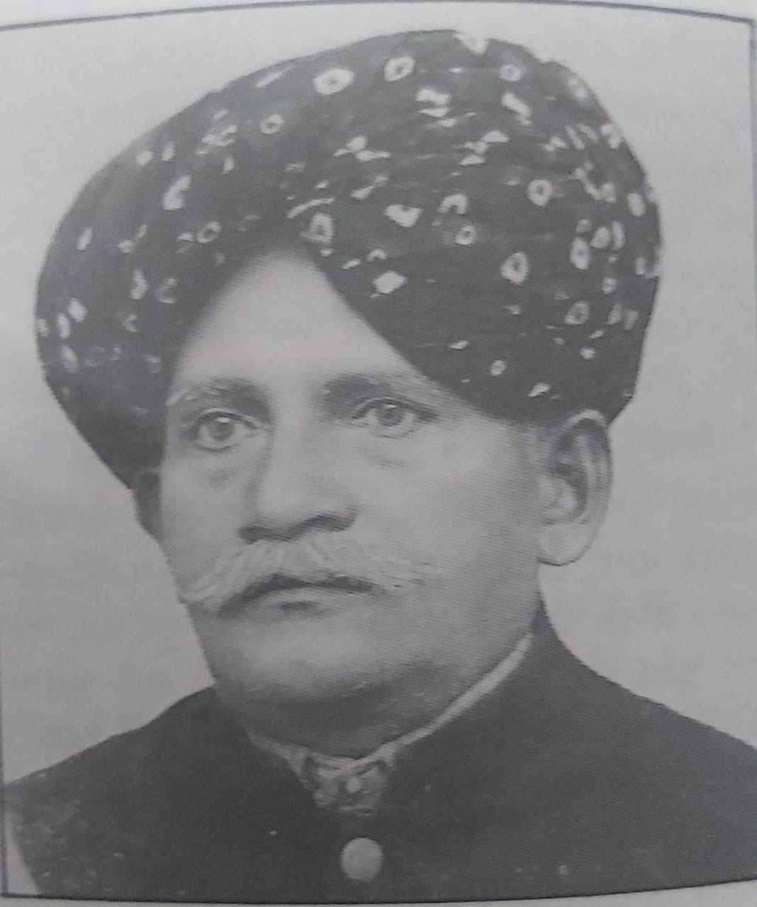
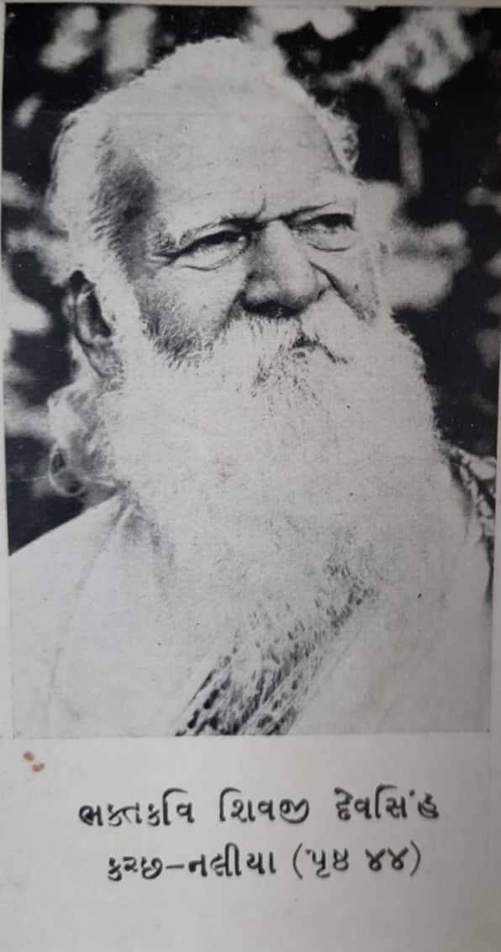
POETS
Kavi Kanak Kushalji
Kavi Pandit Dayaram
Kavi Gautam Sharma
Kavi Kunwarji Vakil
Kavi Abdulha Runza
Kavi Mulraj Anjariya
Kavi Madhav Joshi
Kavi Prangiri Goswami
Maharao Shri Lakhpatji
Maharao Shri Hammirji
Kavi Jivram Ajramar
Kavi Narayan Visanji Thakkar
Kavi Niranjanji
Vrujbhasha Pathsala
Kavya (poems) and Pingal were taught systematically at the unique Vrujbhasha Pathshala in Bhuj beginning in 1749. Lakhpatji founded the Vrujbhasha Pathshala, which trained hundreds of poets who went on to become Rajkavis in various Royal dynasties (Raj Wada). This institution's first principal was Shri Kanak Kushalji Bhattark, and its last principal was Shri Shambhudan Gadhvi.
In his massive two-volume work Kutchna Santo ane, Shri Duleray Karani profiles over a hundred poets.

Slide 21
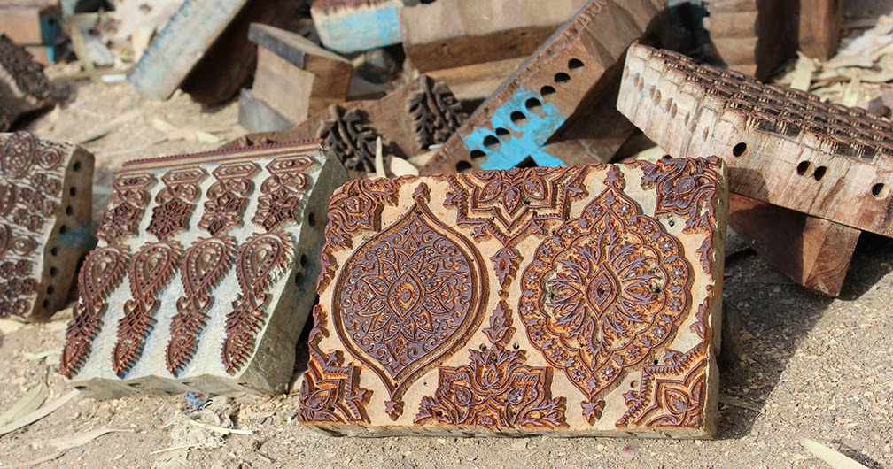
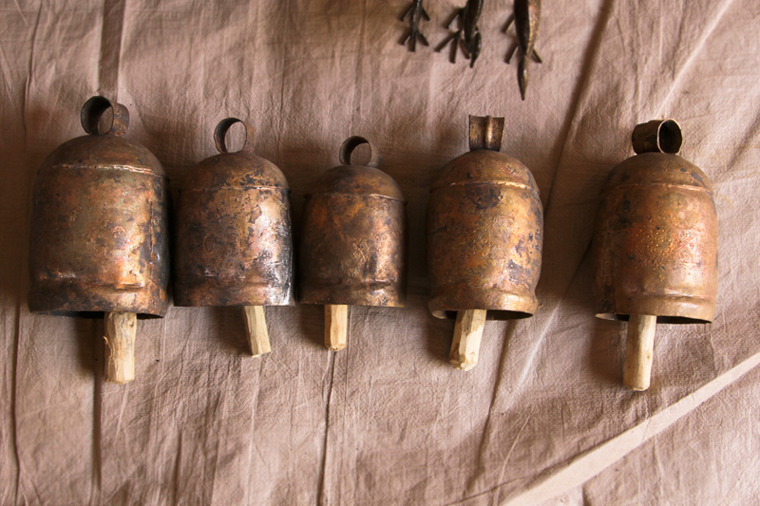
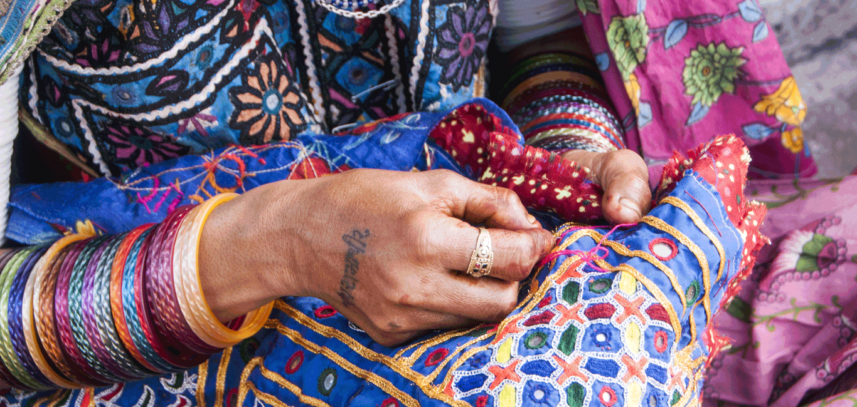
ARTS AND CRAFTS (કળાનો વૈભવ)
End numbers of Artist has contributed to the peculiar art of Kutch. Weaving communities such as Khatris, Rabaris, Ahirs etc. are still continuing the same profession since last many generations and now this art has also received international recognitions. Some art and artifacts are vanishing with the period of time like Kamangar Shailee કમાંગર શૈલી
કચ્છની કમાંગર કલા : શાશ્વત ને જીવંત વારસો
કચ્છની પ્રખ્યાત કમાંગરી ભીંતચિત્રો એક ભૂલાયેલો વારસો

Slide 22
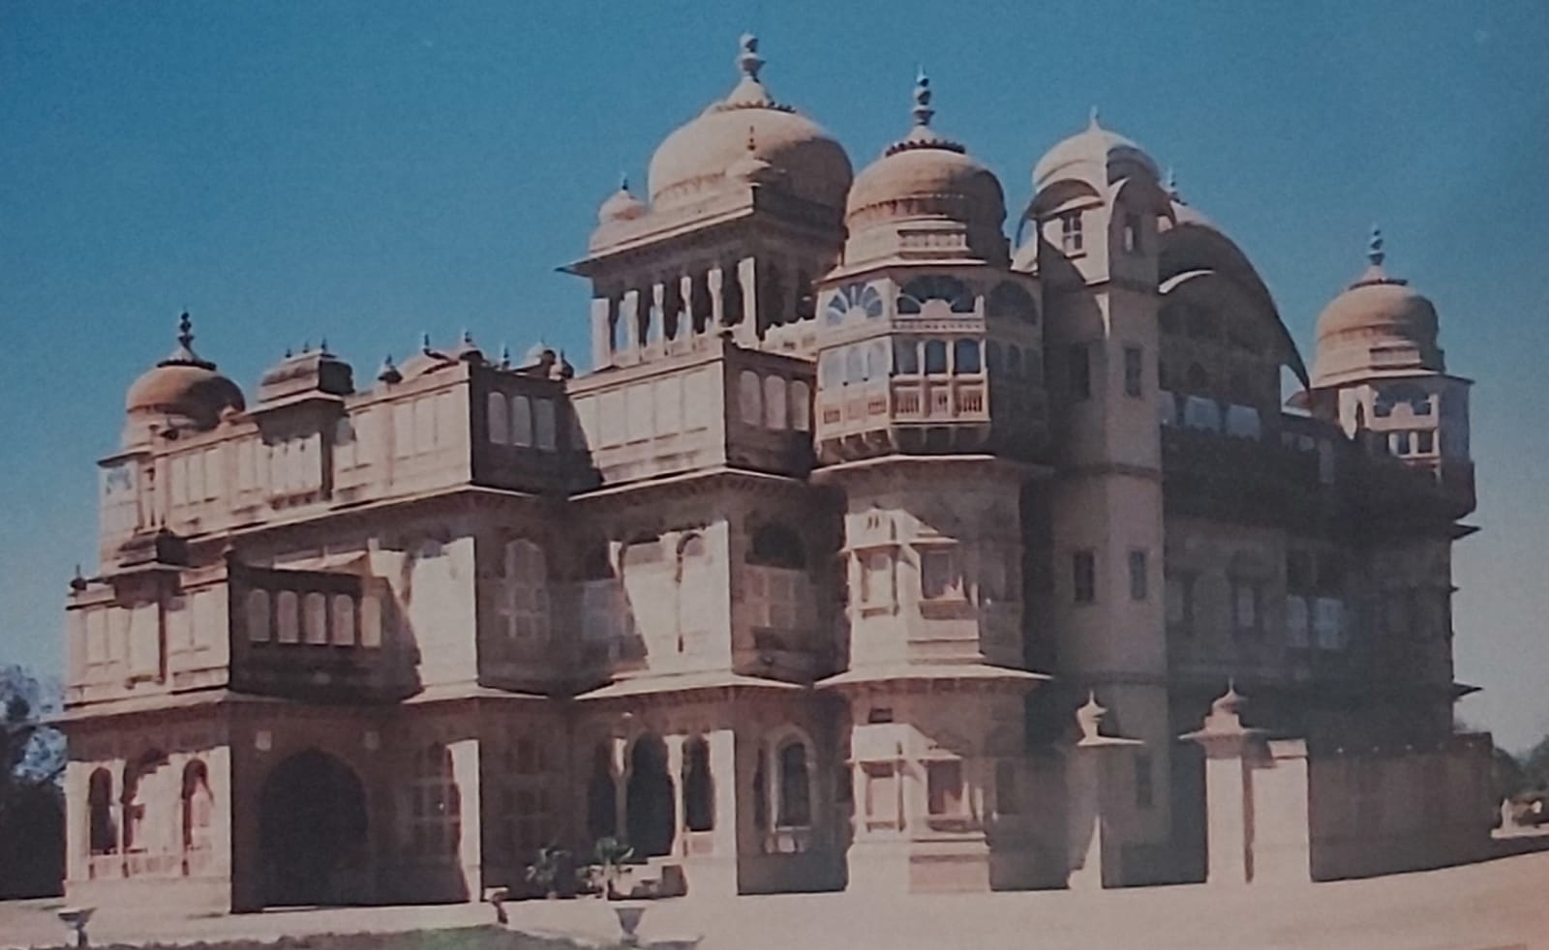
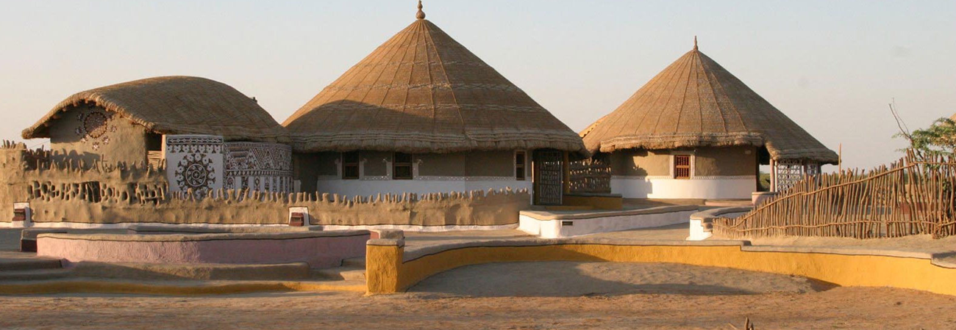
SCULPTURE AND ARCHITECTURE શિલ્પ અને સ્થાપત્ય
Kotay : Ancient Shiv Temple
Kerakot, once the capital of ruler Lakho Phulani, Kerakot Fort, and Shiv Temple
Puaragarh, Puareshwar Mahadev Temple, fort…
Kanthkot : Masjid of Lakhpat, Guru Nanak Smarak of Lakhpat
Jakhau Jain Temple, Bhadreshawar Jain Temple, Vasai Tirth, Panchtirthi of Kutch

Slide 23
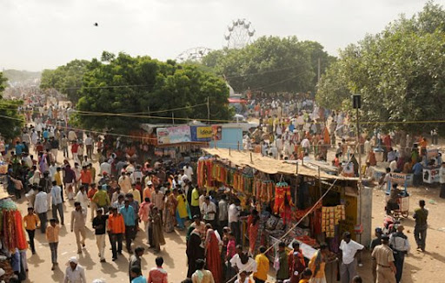
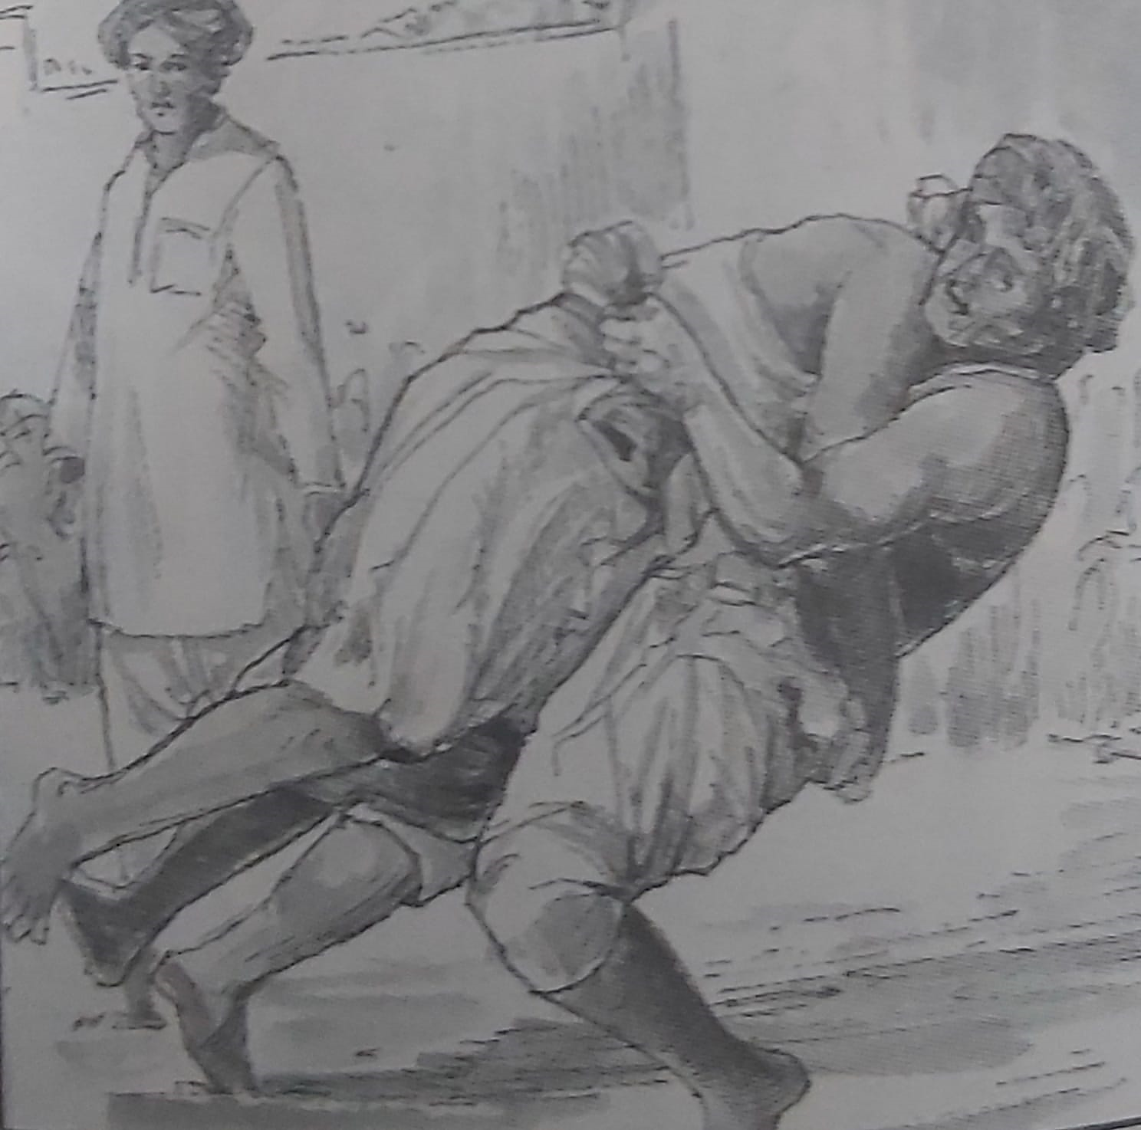
Fairs in Kutch
Narayan Sarovar
Varnudada (Varneshwar)
Mekandada (Dhrung)
Hajipir
Rukanshapir (Talwana)
Jesal-Toral (Anjar)
Rawalpir (Dhrubadi)
Ravechi (Rav)
Sangwari Mataji (Khadir)
Mota Yaksh (Nakhatrana)
Ramdevpir (Vijpasar)
Habuy Mataji (Bhuj)
FAIRS કચ્છના લોકમેળાઓ
Kutch is famous for its various fairs and festivals wherein the people enjoy life by celebrating vibrant festivals. Different communities of Kutch like Koli, Jat Rabari, Megwal, Sodha, and Ahir come together and celebrate these festivals with extreme joy. Among all of the festivals, some are very unique and traditional which everyone must attend. They show the real culture, traditions, ethos and spirit of Kutch. Especially, monsoon is the season when most of the fairs are celebrated. Here are some famous fairs of Kutch.
Ravechi no melo
Mandvi famous ravadi no melo
There are more than 70 fairs are held during the years (religious and non-religious) on several occasions. Every fair has its own importance, faith and peculiarity. Once upon a time, some literature has been published on fairs but now its discerning.

Slide 24
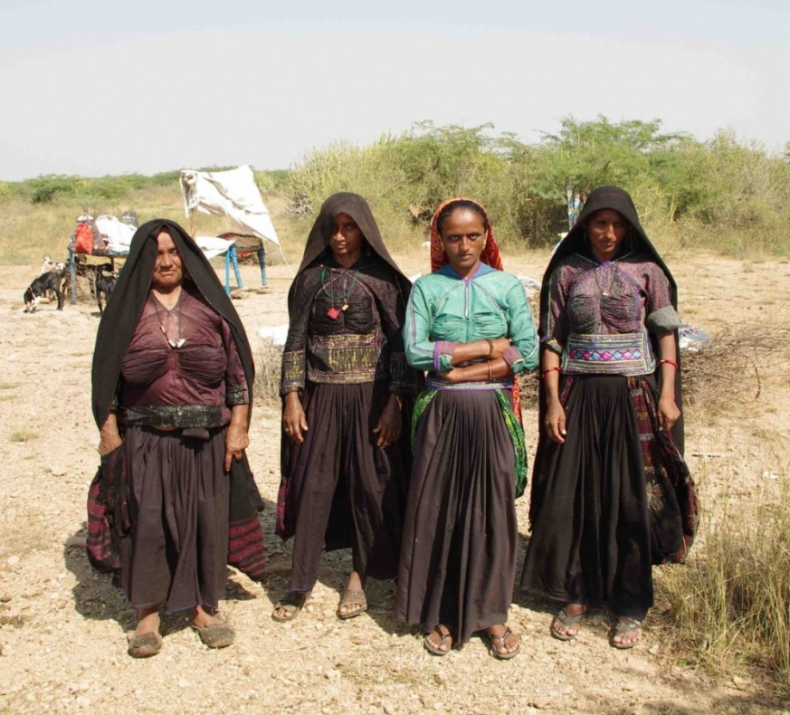
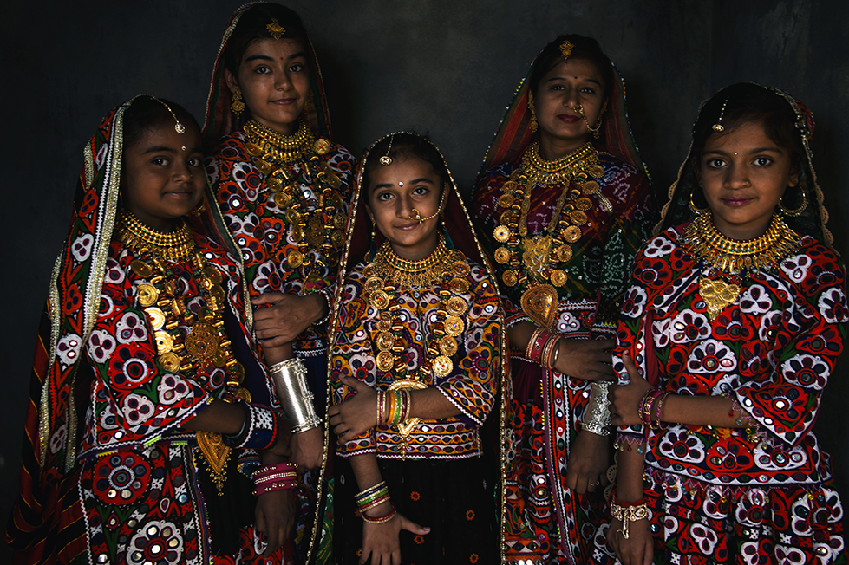
COMMUNITIES
Rabaris of Kutch
Jadeja – Rajput
Patidar – Leva Patel & Kadva Parels (24)
Jain – KVO (52), KDO(42), Vagad (24)
Lohana
Bhatia Medhvad -Harijan
Nagar
Brahman
Charan
Kayastha
Bhanushali
Bhavsar
Gurjar Kshtriya
Rabari
Ahir
Gadaliya
Soni
Sutar
Brahmkshtriya
Kumbhar
Ahirs of Kutch

Slide 25
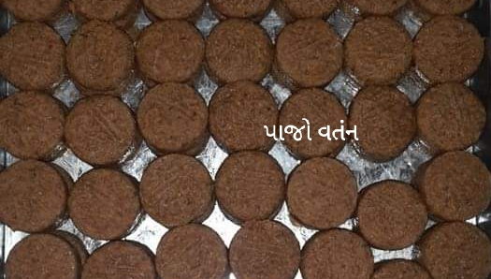
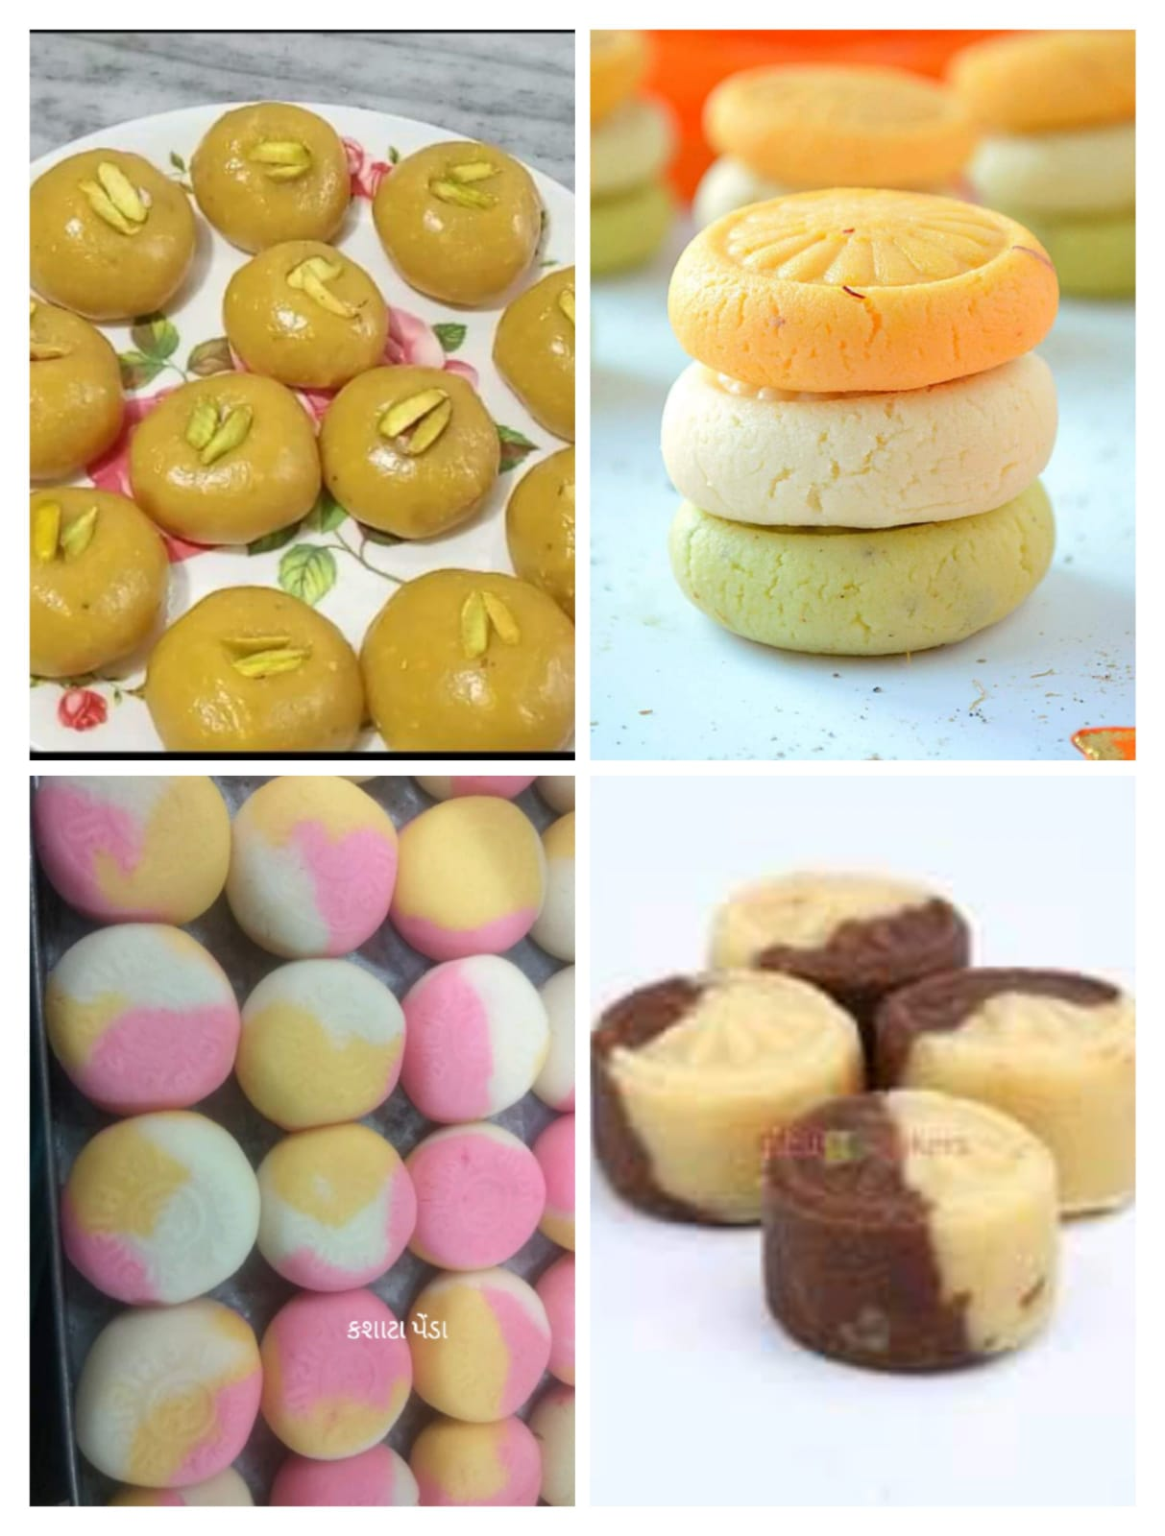
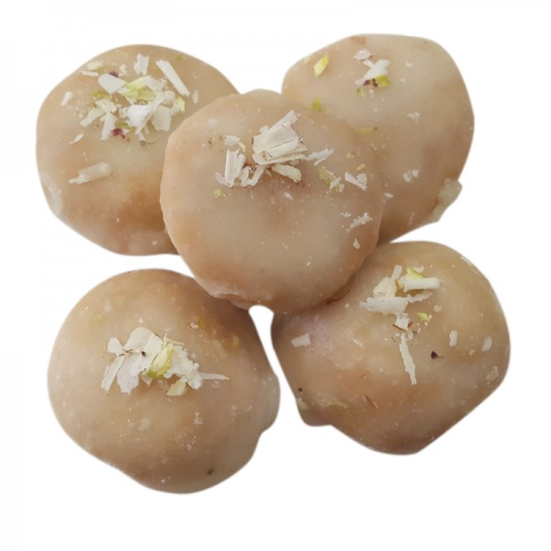
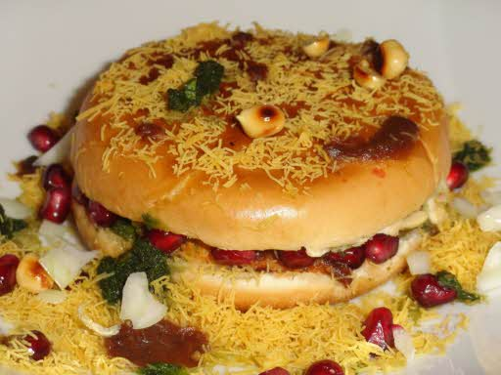
FOOD INDUSTRY
There’s much more to Kutch’s food culture than Double roti, peda and pakwaan. Remembering childhood tastes of pickles, khakhras along with beautiful songs and lots of activities attached while making/creating food.
Food industry has lots of scope of expansion.

Slide 26
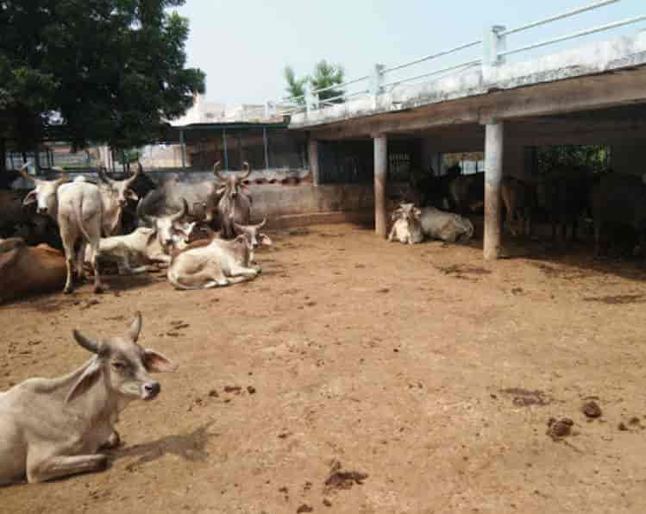
Anjar (1756)
Naliya (1849)
Mundra (1861)
Bidada (1874)
Bhujpur (1874)
Durgapur (1900)
Madhapar (1926)
Manphara (1937)
Gundala (1940)
Adhoi (1953)
Bhachau (1954)
Ratadiya (1967)
Wadala (1985)
Nakhatrana (1986)
Chhasara (1994)
પાંજરાપોળ સંસ્કૃતિ JIVDAYA
Panjarapods, Dhorwadas and Chabutaras and Havadas are emerged from concept of Jivdaya. There are many Panjarapods and Taluka and Village level functions on Mahajan Tradition/s There are few unique Chaburata and villages has multiple Havadas for animals.

Slide 27
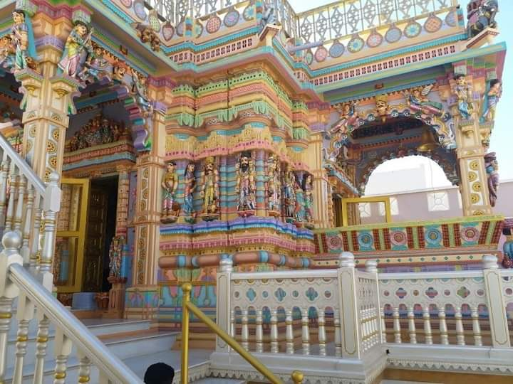
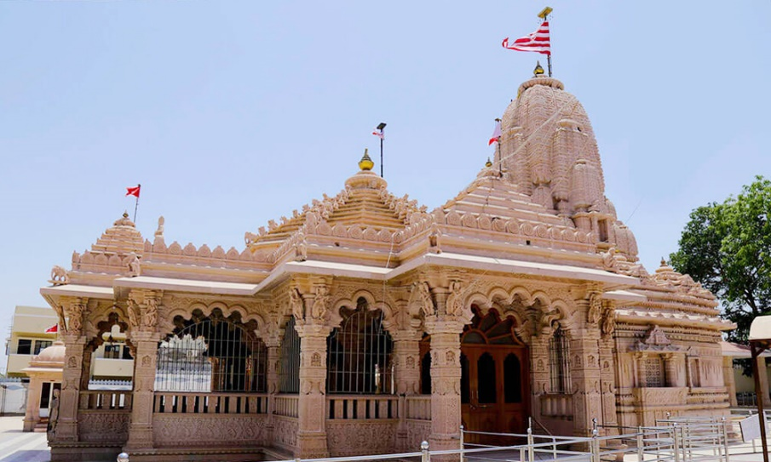
કચ્છના કીર્તીમંદીરો અને યાત્રાધામો
There are many Jain Temples across the Kutch, with unique architectural touch and few of them are more than 200 years old. Panchtithi, still very famous among Jains. There are other temples of faith like, Matano Madh, Ashapura, Narayan Sarovar etc. Few years back, small book/s were published on the sameJagdu Datar (Bhadreshwar Jain Temple) and Saudagar Sundarji were responsible for construction of and renovation of these temples.
Kutchna Kirtimandiro Ane Yatra Dhamo
Jain Ashram, Mandavi (1948)
Nirvasiteshwar NatMandir, Adipur (1951-52)
Dadabari Sankul, Bhuj (1960)
LeelaShah Ashram, Adipur (1963)
Ayappa Temple, Gandhidham & Bhuj, Bharatiya Sanskruti Darshan – Kutch, Bhuj (1980)
Kutchna Gayatri shaktipitho
Ram Darbar, Bhuj (1984)
72 Jinalay, Koday (1987)
Balaji Temple, Kandala
Zulelal Mandir, Gandhidham
Ambedham, Godhara, (1992)
Ram Mandir, Vandhay (1907 & 1944)
Shivparas Dham, Bhuj
RamKrishna Seva Bhavan, Bhuj (1999)
Bhujna Nutan Jinalauyo
Parshva Vallabh IndraDham, Mota Jakh
Punit Yatra Dhanm, Abdasa

Slide 28
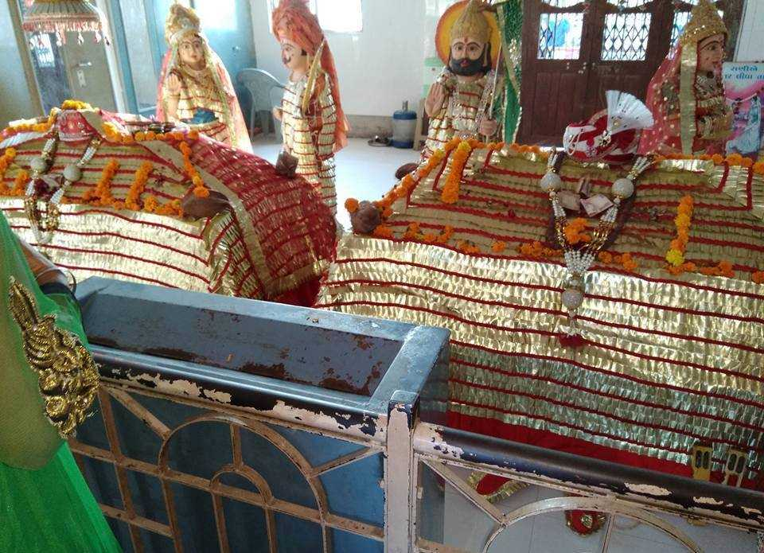
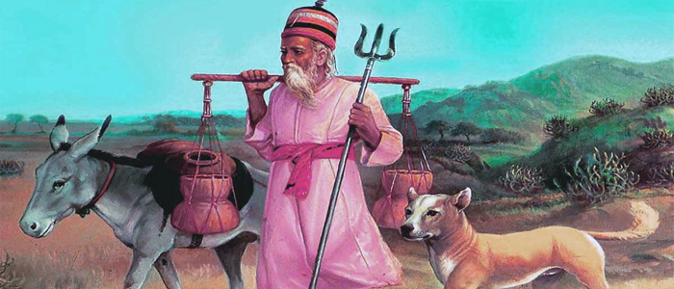
Shri Dulerai Karani has listed around 68 Saints (short profiles)
Mekandada
Jesal Toral
Sant Shiromani
Swami Sajahanand
Shri Vrujpalji Swami
Dungaro Bhagat
Hajipir
Ratno Bhagat
Sadhavi Maiya
Yogini Anand Lahiri
Sati Dahi Dumani
Jakh Dada
SAINTS
Saints are being forgotten now a days. In 1971, Ravindra Dave made classic film on Saint Jesal Toral. (50 Years back).
Hajipeer is an example of communal harmony!!!!

Slide 29
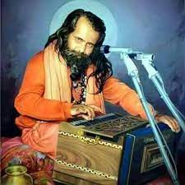
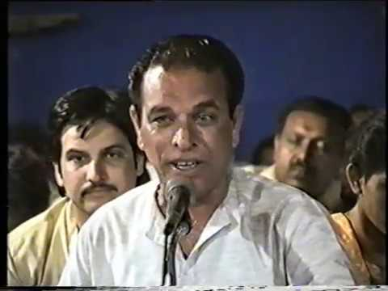
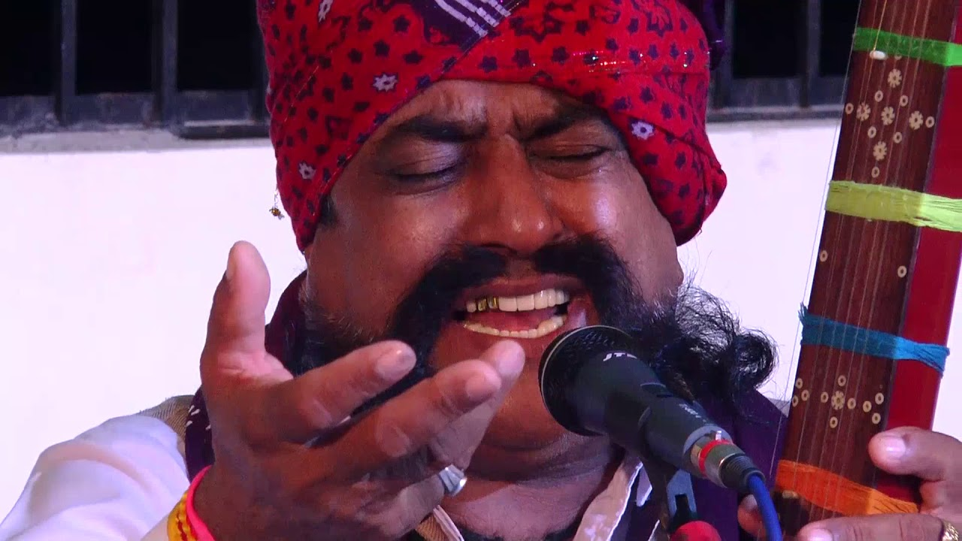
લોક ડાયરો
Lok Dayras are more famous among Rural and Semi-rural areas of Kutch. Saint Narayan Swamy had a large fan following. I am witness to a night long Bhajan Sessions of Narayan Swamy. At present, many singers have got an international recognition and part of Kabir festivals (very reputed music festival). Every artist has its own peculiar style and fan-followings.

Slide 30
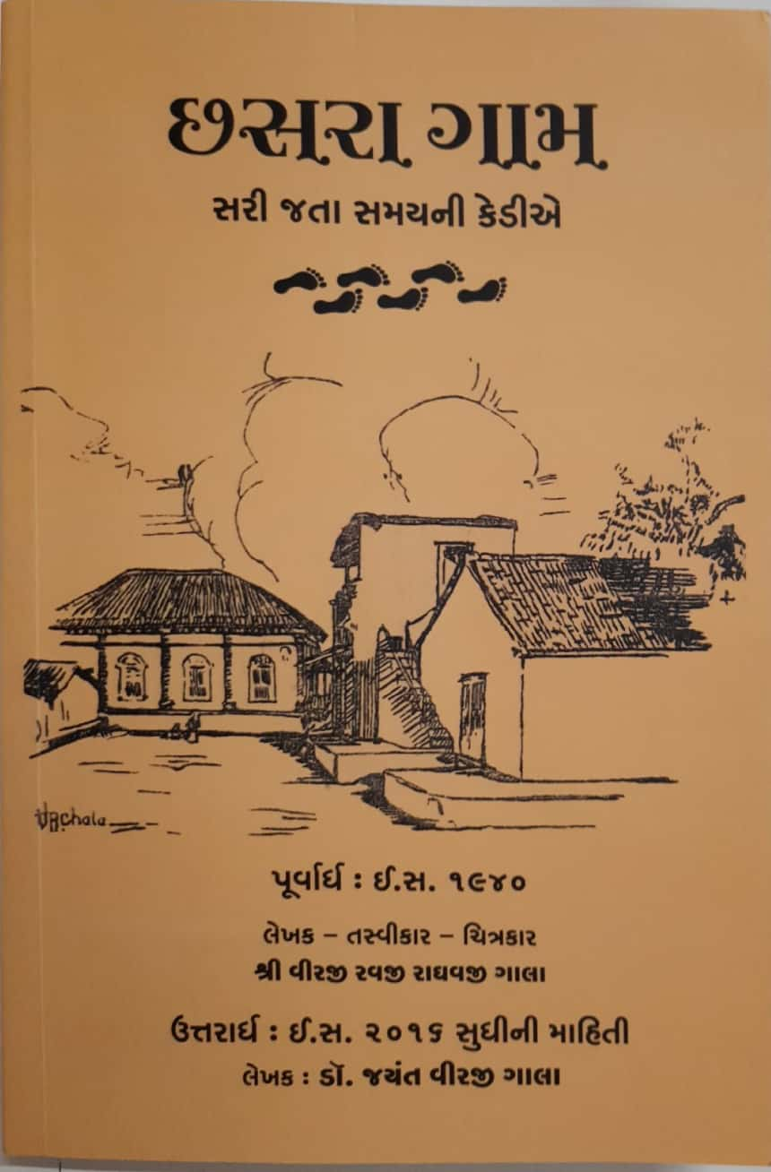
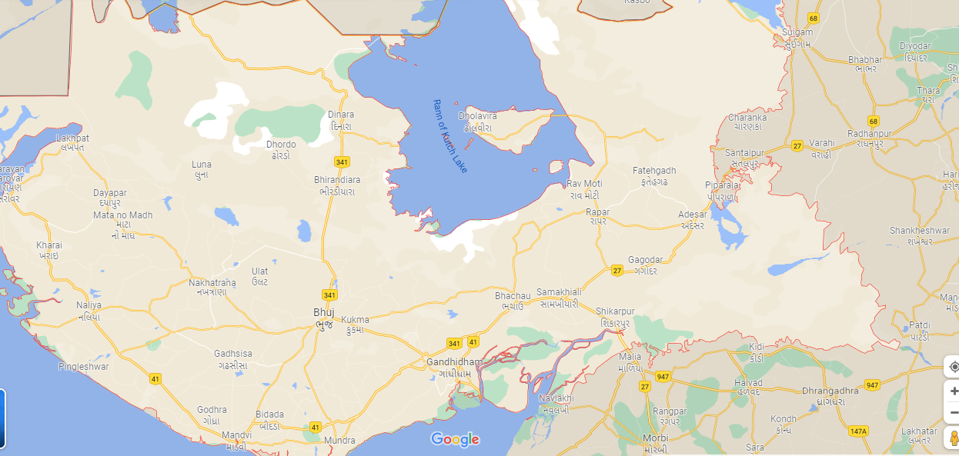
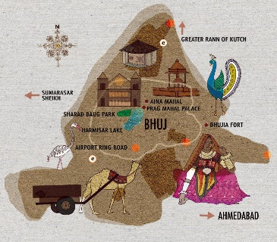
VILLAGE HISTORIES AND ITS UNIQUENESS ગામડે જી ગાલ્યુ
There are total 946 villages in Kutch, having 631 Panchayats. Many villages have its history written or well said. Villages are having multi-communities and stating in harmony. Larger villages had a different segment (વાસ), and all were interdependent. ચારણ વાસ, હરીજન વાસ, ખરવાડ, સતિયા, now, this tradition is getting disintegrating with advent of time.
ફળિયા સંસ્કૃતિ
ઓટલા મેડાવા
ચોરાયા

Slide 31
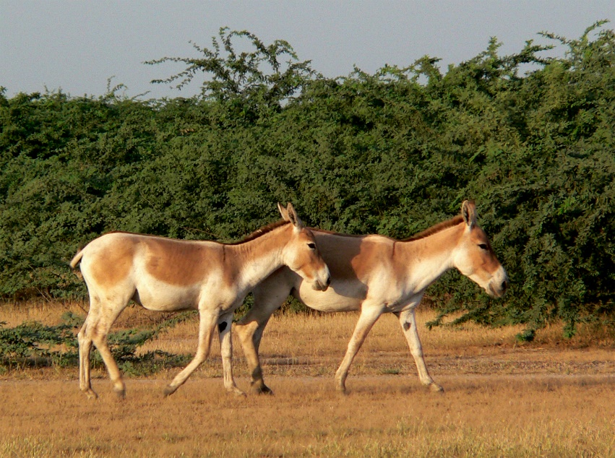
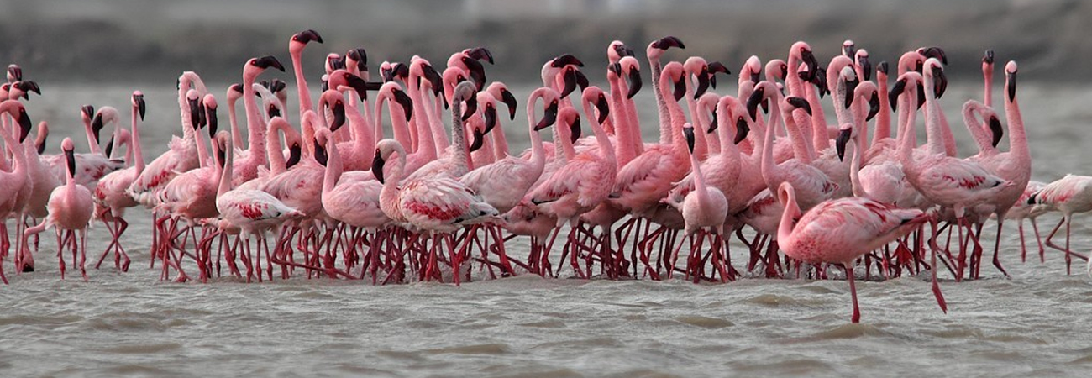
WILDLIFE
There are special categories-Kharai Camel, Donkey, Flamingo migratory birds (સુરખાબ), which attracts lots of tourist. Each one has its take.

Slide 32
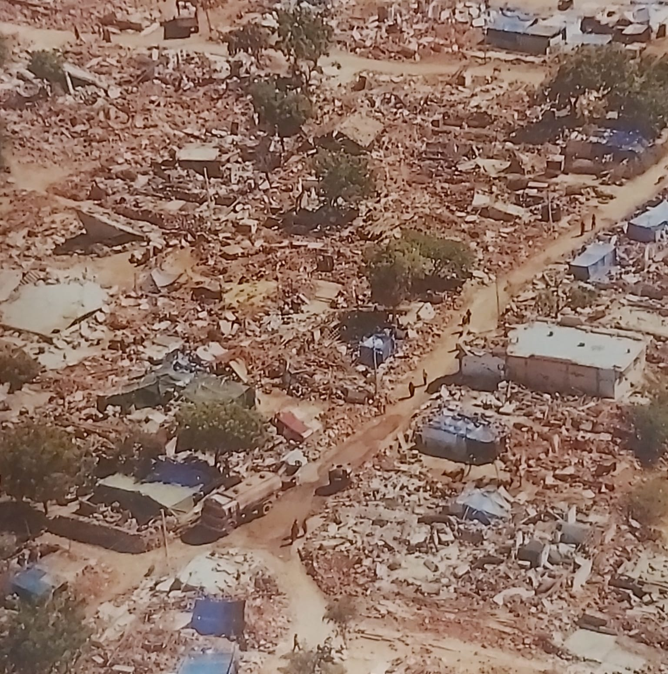
ધરતીકંપ
From 1819 to 2001, Kutch had an extreme long history of earthquakes. Kutch's geology has been changed as a result of these earthquakes. The detailed history of earthquakes at Kutch has been documented as follows;
Dates | Destruction
16th June, 1819 | Wednesday, 6.45 p.m., duration 2 minutes, richter scale of 8. In Bhuj, 700 houses were destroyed, and 1140 people were killed. In Anjar, 1500 houses were destroyed, and 160 people were killed.
21st July, 1956 | Saturday, 9.01 p.m., Anjar and Bhachau to Bhuj: It lasted 51 seconds and killed 114 people.
26th Jan, 2001 | Friday, 8.46 a.m. on a 6.8 richter scale, 12,221 people were killed. Out of 884 villages, 518 were affected and 1.25 million houses have been destroyed.

Slide 33
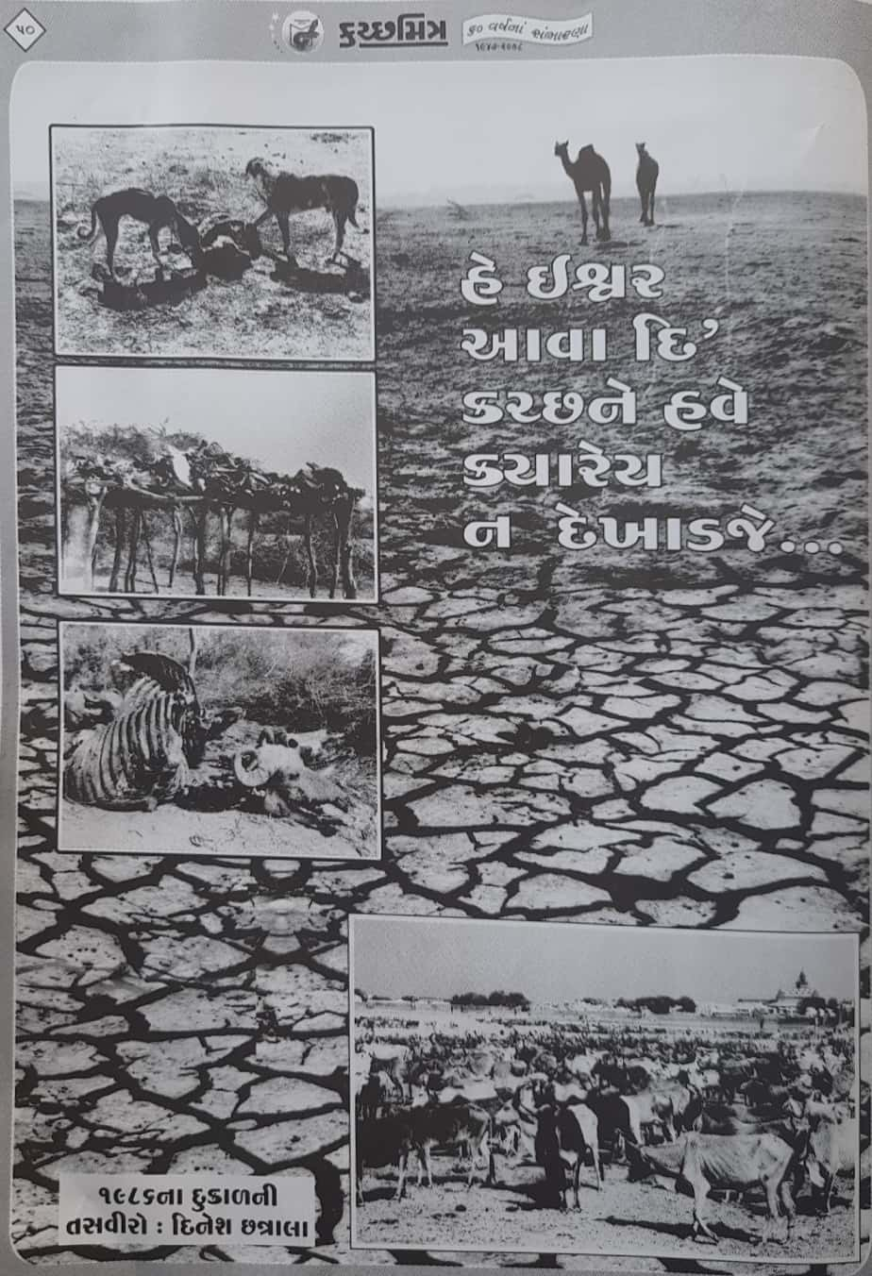
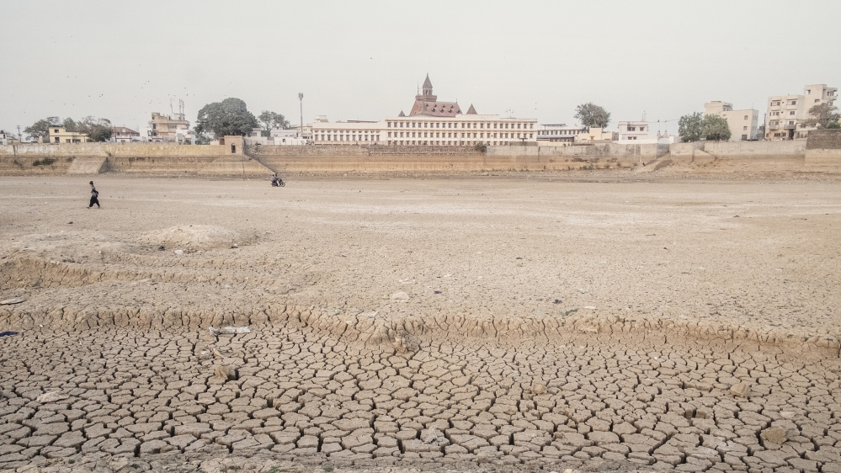

Drought (દારુણ દુષ્કાળ)
Kutch is a drought-prone area. Baring last decade, Kutch has had a vast history of drought which has created a lot of migration of human beings since last few centuries. Kutchi’s have been spread across the world. The details of recurring drought is mentioned below;
River Sindhu stopped flowing in Kutch from 1819 onwards; this compelled the frequent droughts in the Kutch region (Entire North Gujarat).
Kutch has a long history of Drought Years that begins from 1791, 1796, 1803, 1813, and goes on…
From 1791 till Independence, 40 years of drought at the interval of every 3 to 4 years.
Post-independence, 1968 and 1969 was the consequent drought years.
The years 1985, 86, and 87 were the worst drought years of the last three centuries.
Major relief work started with the injunction of funds from outside Kutch (Mahajan stepped in).
In 1993, Kutch experimented with artificial rain...
Hamisar Lake

Slide 34


BANNI REGION
Why is it called Banni?
3847 Sqr Km Area
Biggest Grassland of Asia
43 different Types of Grass
Pastoralism, Handicraft, Embroidery, Woodcraft
Typical વાંઢો (Hamlets)
જત, મારવાડા, નોડે, નોતિયાર Communities
કચ્છ જી રણ કંધી મથે નીલી બન્ની ન્યાર નીલા નેશ નવાણ ને ધા મીઠા ગુલઝાર ઞોયુ, મૈયુ મતારીયુ, ઘી, મખણ અપાર પ્રો ફૂટી પ્રભાત થઈ, હોત છાય કે છબકાર
Photo by Ovee Thorat.

Slide 35

PASTORAL CULTURE - REALITIES, CHALLENGES, (માલધારી સંસ્કૃતિ)

Slide 36


SERIOUS KHEDUT (AGRICULTURAL) SUCCESS STORIES

Slide 37

KUTCH – NARMADA જીવાદોરી

Slide 38


PORTS AND SHIPBUILDING (વહાણવટું)
કચ્છી વહાણવટાની કુશળતા ઉપર ભરોસો રાખીને મોગલ શહેનશાહોએ હજની યાત્રાએ જતા યાત્રાળુઓને લઇ જવા-લાવવાનુ કામ કચ્છ રાજ્યને સોંપ્યું હતું અને તેના બદલામાં કચ્છની ખંડણી માફ કરી હતી.
In 1868, ships docked at various major ports
Mandavi (268)
Tuna, Anjar (62)
Lakhpat (16)
Mundra (26)
Jakho (29)
Vavaniya (25)
Few minor ports were also functioning like Rohar, Zinzoda, Koteshwar
Major Ports Post Independence
Kandala (1955) Free Trade Zone
Mundra -Adani (2000)

Slide 39



TOURISM
Every year, the Gujarat Tourism Department at Gujarat Government organizes રણોત્સવ, a cultural extravaganza. During the event, there will be folk dancing, musical performances, shopping malls, a camel safari, a bird watching safari, and a horse ride.
Pilgrimage Tourism
Eco Tourism
Heritage Tourism (Museums, Palaces)
Bird Safari
Ayurveda Tourism (Naturecures)
Disaster Tourism
Border Tourism
Cinematic Tourism

Slide 40


KUTCH: ON THE PATH OF INDUSTRIAL DEVELOPMENT
Kachchh is home to the world's largest producer of Submerged Arc Welded (SAW) pipes.
Factors:
Infrastructure Development Post 2001 Earthquake
Tax Holidays And Incentives To Industry
New Industrial Policy
Cement
Sanghi Group
Power
Tata & Adani
Mineral
Ashapura
Major Industries Before 2001 Earthquake
Agrocell
IFCO
Sanghi
Solaris
Adani Wilmar
Adani Port
Kandala Port
Ashapura
PSL
Jindal
Friends Group Of Cos
Port
Adani
Salt
600 Year Old Activity
Textile
Welspun

Slide 41

UNIQUE EDUCATION MOVEMENT
સદાગામ પ્રવૃત્તિ, કોડાય
વ્રજ પાઠશાળા, ભૂજ
વિરાયતન
કન્યાશાળાઓ
Boarding Education in various villages of Kutch post-independent

Slide 42

LIBRARIES
Every major village has its independent library room / premises, some of them has multiple libraries.
General Library (News Papers and Books) Mahila Library જ્ઞાન ભંડારો were catering saints and religious based literature Village Bhujpur has three story independent premises of library.

Slide 43



LITERATURE - સાહિત્ય લોકકથાઓ

Slide 44

ગ્રામીણ પત્રકારત્વ (RURAL JOURNALISM)
Rural Journalism in Kutch was invented by Shri Kirtibhai Khatri which was implemented by him through Kutchmitra. It changed the entire dynamics which was quite evident from the circulation figures of Kutchmitra and the said newspaper became a self-reliant. It’s the great achievement and landmark in itself.

Slide 45




નારીશક્તિ WOMEN’S PROWESS

Slide 46



NGOs
Sadagam Trust (1871)
Charkha Madhi (1939)
Bhimani Khadi Kendra (Mandavi), 1951
Shri Sangh Ratadiya (1968)
Gram Swaraj Sangh, Nilapar (1978)
Kutch Vikas Trust (1980)
Navchetan Andh Apang Kalyan Mandal
Virayatan Vidhypith (1973)
Sarasvatam Education Trust (1968)
VRTI (1975)
Shrujan – LLDC (1968)
Sahajeevan (1968)
Hunnar Shala Foundation (2001)
Khamir (2005)
Kala Raksha (2005)
KMVS (1989)
Kutch Navnirman Abhiyan (1989)
Prayas
Bhojay Sarvodaya Trust (1998)
Bidada Sarvoday Trust (1974)

Slide 47
THANK YOU

